Slide 1
Environment setup & Lab0

Slide 2
Outline
Environment setup
How to run your code
Lab0

Slide 3
Outline
Environment setup
How to run your code
Lab0

Slide 4
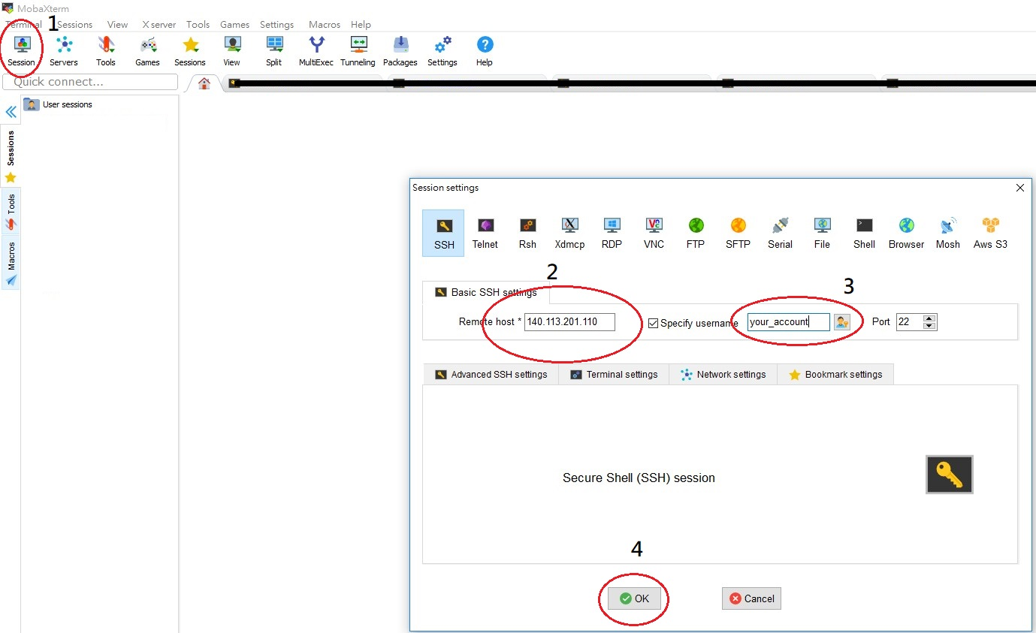
MobaXterm Setting
Ip: 140.113.201.111
Password: mlintro2020s

Slide 5
First log in
You must to do it when you log in for the first time
Change your password
$ passwd
Run the shell to enable x11
$ sh /opt/script/autokeygen.sh

Slide 6
Process command
$ srun --gres=gpu:1 -u --x11=first your_process
--gres=gpu:1 : set one gpu for your process
-u : show the console information without buffering
--x11=first : x11 to return the window
Example :
$ srun --gres=gpu:1 -u --x11=first python train.py
PC414 Rules:
PC414 allocate each user only 1 GPU
Each allocation of resources limits in 24 hours. After that, the process will be terminated.

Slide 7
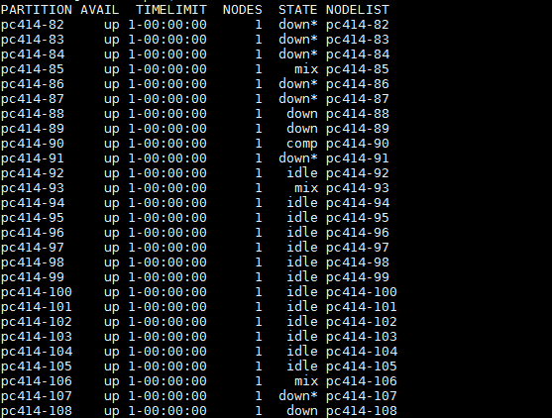
Check gpu resource
$ sinfo
idle : gpu that is idle and available
mix : gpu that is working
down: gpu that is not available

Slide 8
Job Queueing
1. GPU is not enough.
Use $sinfo to check if there is any available GPU
2. The previous job does not release.
Check your job on server:
$ps axo user:20,pid,pcpu,pmem,vsz,rss,tty,stat,start,time,comm | grep mlintro_2019_yourID | grep srun
Kill job ID with SI+:
$kill JOB_ID_Sl

Slide 9

Remote jupyter notebook
Generate the jupyter notebook config file
$ jupyter notebook --generate-config
Create password for your notebook
$ jupyter notebook password

Slide 10
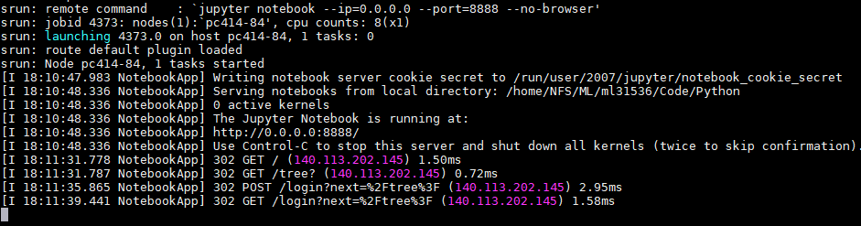
Remote jupyter notebook
Enter command to start your notebook
srun --gres=gpu:1 -uv --x11=first jupyter notebook --ip=0.0.0.0 --port=8888 --no-browser
srun -uv --x11=first jupyter notebook --ip=0.0.0.0 --port=8888 --no-browser (without GPU)
Remember the postfix number, 84 here
Remember the port number, 8888 here

Slide 11
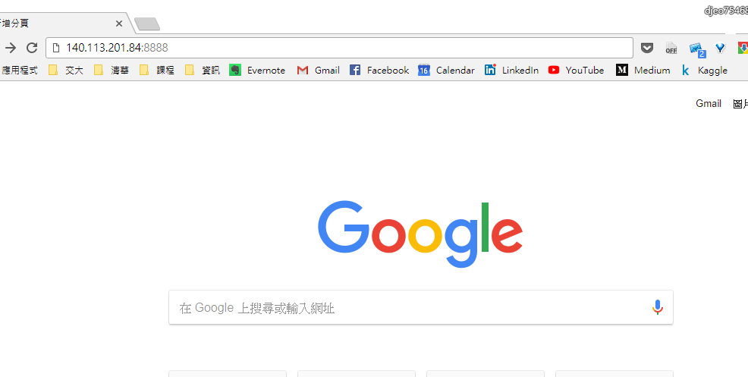
Remote jupyter notebook
Enter the ip: 140.113.201.XX:xxxx on your explorer.
XX is the postfix number you just remembered, and xxxx is the port.

Slide 12
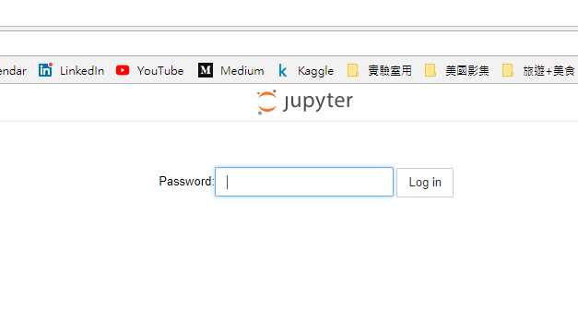
Remote jupyter notebook
Enter the password you created.

Slide 13
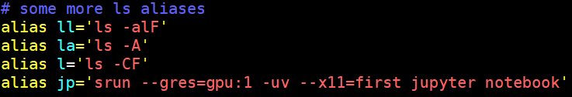
Alias
For running the commonly used command more easily, you can set alias.
$ vim ~/.bashrc
Edit the alias you want.
Close the terminal and open again.
Then, you can run the command with shorter command.
For example, $ jp

Slide 14
Outline
Environment setup
How to run your code
Lab0

Slide 15
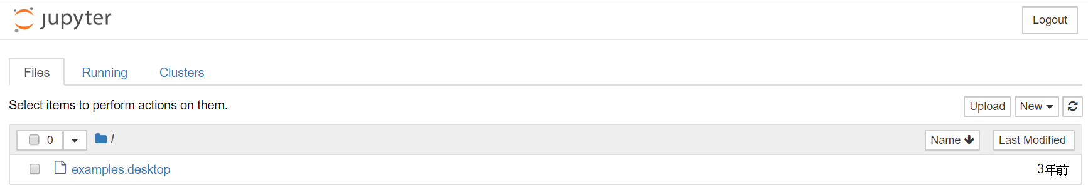
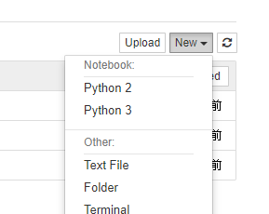
Jupyter notebook
After logging in the jupyter notebook
You can create file on your own.

Slide 16
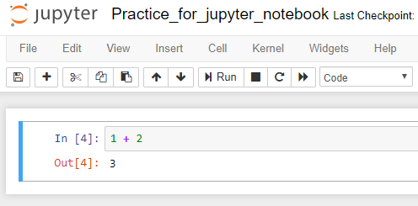
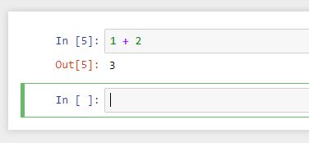
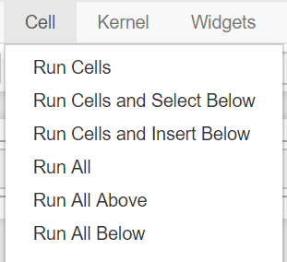
How to run the code?
Ctrl + Enter
Run the current cell
Shift + Enter
After run selected cell, it moves to the next cell
Run All / Run All Above / Run All below

Slide 17
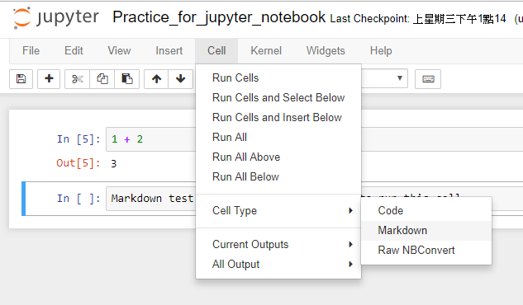
How to add markdown?
Change the cell type
And run it.

Slide 18
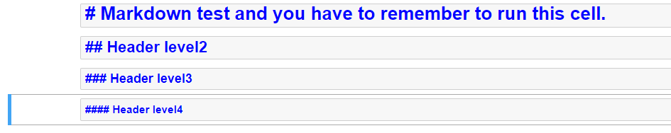
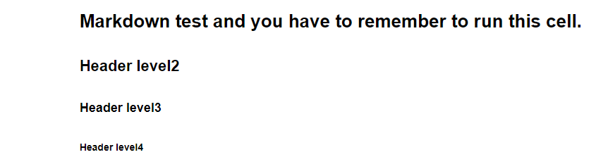
How to add markdown?
When cell type is markdown, we also can change its size by using #.
After

Slide 19
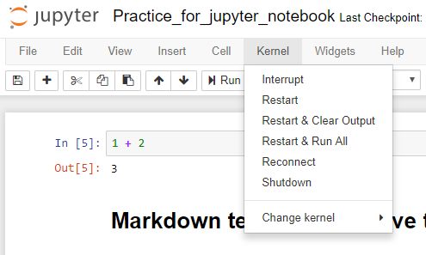
Kernel
Interrupt
When we are running code, and we want to stop it. We can use it.
Or press the shortcut “ii”
Restart
Clear all the variables, release resources, and restart again.
Shutdown
Clear all the variables, release resources.

Slide 20
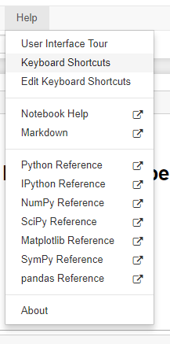
Shortcut
There are many shortcuts you can use or edit.
Recommend to remember some of shortcuts.
“a”
“b”
“ii”
Ctrl+Enter, Shift+Enter
“m”
“y”
“dd”
“z”

Slide 21
Important
After you finish running your code and will not use it for a short time.
You should shutdown the kernel to release resources for others.
Close the web browser.
Then, press “ctrl + C” in the command line

Slide 22
Outline
Environment setup
How to run your code
Lab0

Slide 23
Download the files
Please download the file from mlintro2020sta01 account：
$ tar -xvf ~mlintro2020sta01/Lab0/Lab0.tar

Slide 24
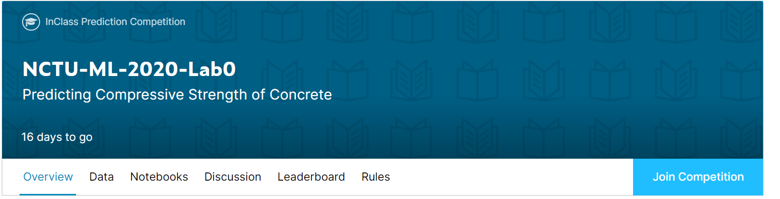
Join the Kaggle competition
Create Kaggle account first
Competition URL:
https://www.kaggle.com/t/cc3d3104a5054a37957531ce56f01f37

Slide 25



Lab0 Overview
You need to be familiar with jupyter python and useful library
numpy, pandas, matplot, etc
If you are not familiar with python, I strongly recommend you to see 莫凡’s python tutorial. (or other online materials)
https://morvanzhou.github.io/

Slide 26
Lab0 Overview
Task: Linear Regression
Dataset: Concrete Strength prediction dataset
Input variable
Cement, Blast Furnace Slag, Fly Ash, Water , Superplasticizer , Coarse Aggregate, Fine Aggregate, Age
Output variable
Concrete compressive strength (csMPa)
Given input variables, you should use linear regression to predict the value of output variable(csMPa)

Slide 27
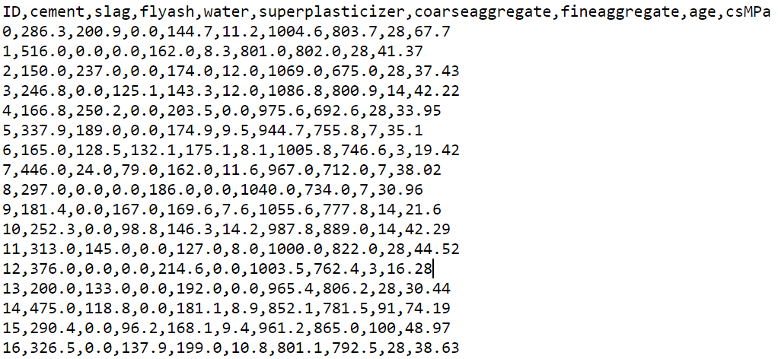
Lab0 Overview
Dataset: Concrete Strength prediction dataset
train.csv (824 rows)
output

Slide 28
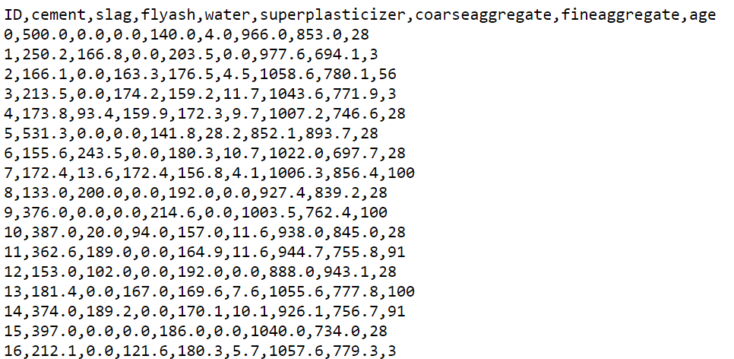
Lab0 Overview
Dataset: Concrete Strength prediction dataset
test.csv (206 rows)
You should output csMPa

Slide 29
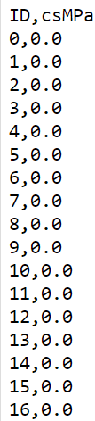
Lab0 Overview
Dataset: Concrete Strength prediction dataset
sample.csv (206 rows)
You should write your prediction to a csv file
The format is on the right
First row should be ID,csMPa
From second row, you should write ID and the value of csMPa
separated with “，”

Slide 30
Lab0 Steps
Read files and extract features
Read files
Hint: use numpy or pandas to read csv files
Extract features
Store input variables to X
You can do normalization
Store output variables to y

Slide 31





Lab0 Steps
Implement linear regression
Use L2 loss
$y=Xw$
Pseudo code
Declare weight vector(w), learning rate and #of iteration
for i_th iteration:
$y_{predict}=Xw$
$Loss=L2Loss\left(y_{true},y_{predict}\right)$
$gradient=−2∗X(y_{true}−y_{predict})$
$w−=learning rate∗gradient$

Slide 32
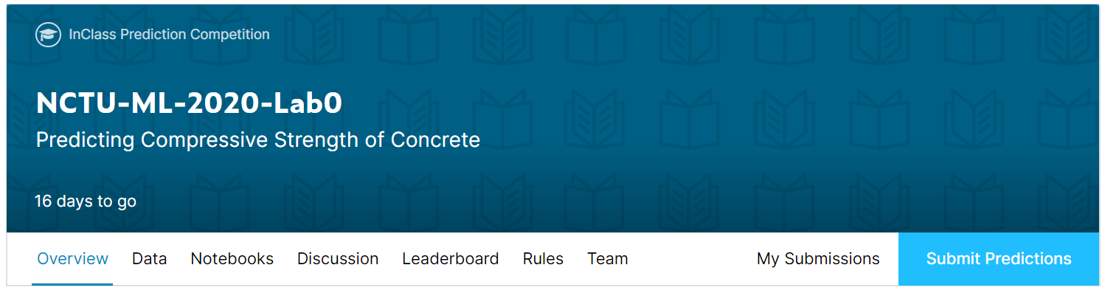
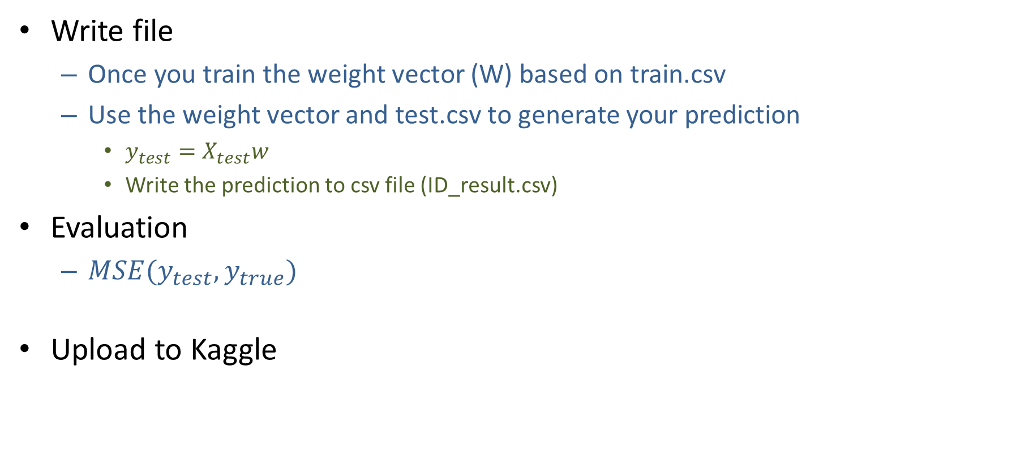
Lab0 Steps
Write file
Once you train the weight vector (W) based on train.csv
Use the weight vector and test.csv to generate your prediction
$y_{test}=X_{test}w$
Write the prediction to csv file (ID_result.csv)
Evaluation
$MSE(y_{test},y_{true})$
Upload to Kaggle

Slide 33
Assignment Regulation
Please use jupyter notebook to finish this lab (.ipynb)
Only Python3.6 available
You don’t need to use GPU in this lab
Package available
numpy
pandas
Scikit-learn
請實作linear regression，方法限定使用Gradient Descent。

Slide 34
Lab0 Gading policy
Lab0(1%)
If
The MSE loss shown on Kaggle is below 120 (40%)
You have finished the code and upload it to E3 (60%)
Then
You will get 100 in this Lab
請勿抄襲 (抓到以0分計算)

Slide 35
Reminder
Submit Deadline : 2 week (03/20/2020 11:59 PM)
You need to submit your code to New E3 and upload the result to Kaggle
Hand in your code and in the following format
Lab0_studentid.ipynb

Slide 36
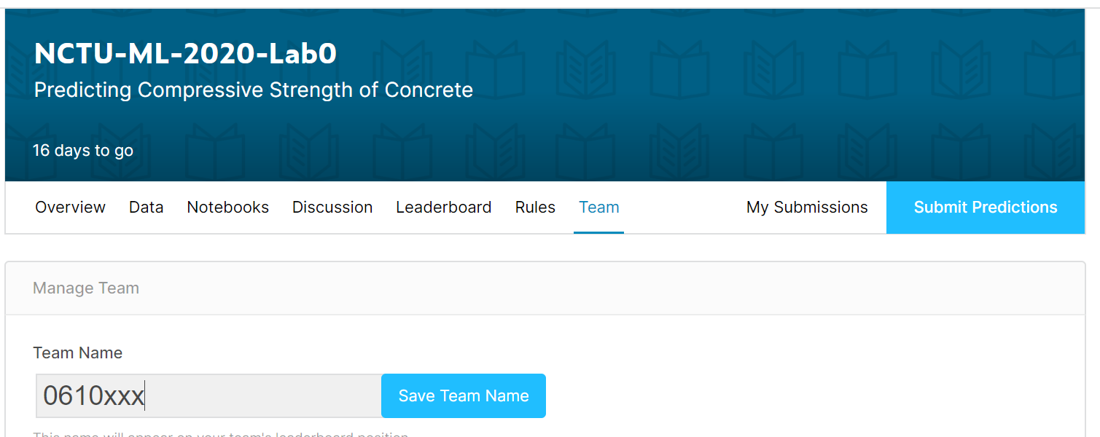
Notice!!!
Change your team name to your ID
If TA can not find your ID, you will loss 40% of score in this lab directly
You only have 10 times maximum daily submissions

Slide 37
Shut down your kernel !!!!!
Remember to SHUTDOWN the kernel
To release resources for others.

